Slide 1

Indian Institute Of Information Technology, Allahabad
Computer Organization and Architecture
Semester Project

Slide 2
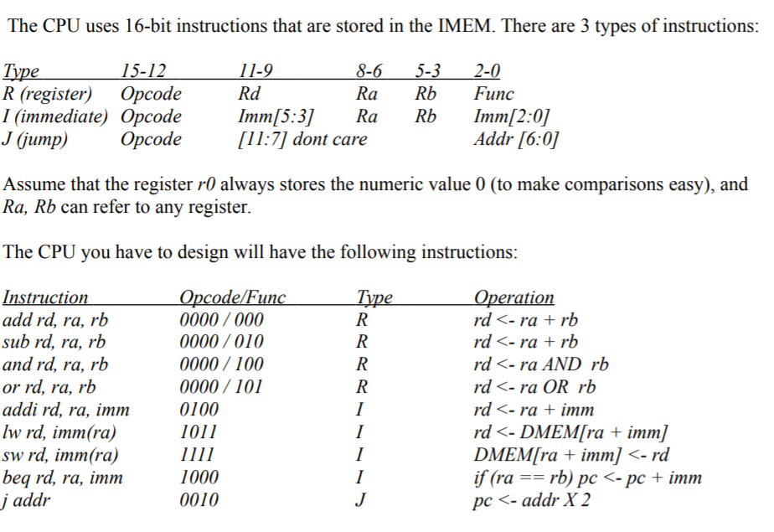
Introduction

Slide 3
Program Counter
Load
Enable
Reset
Clock
#1
PC
Addri[8]
Addrb[8]

Slide 4
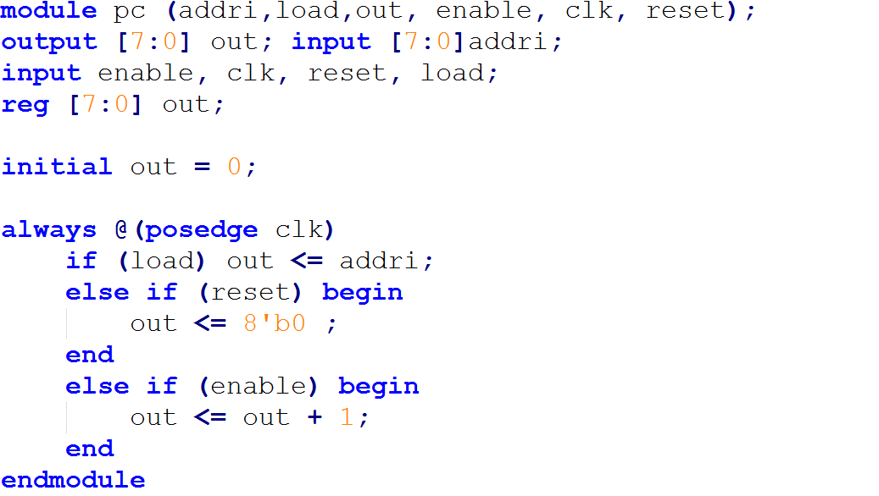
Program Counter – Code/function

Slide 5
Instruction Memory
Addrb[8]
IMEM
IW[16]

Slide 6
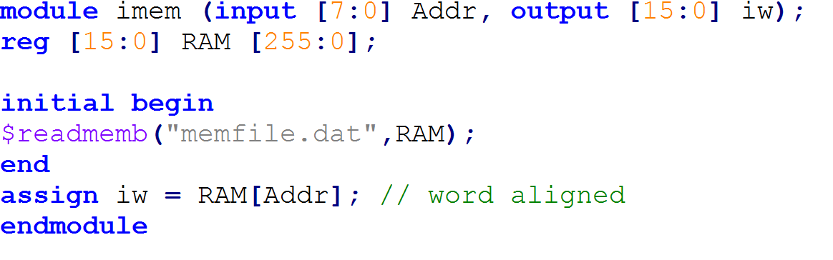
Instruction Memory - Code

Slide 7
Instruction Register
IW[16]
IR
Op[4]
Ra[3]
Rb[3]
Rd[3]
Func[3]
Imm[6]
Addr[7]

Slide 8
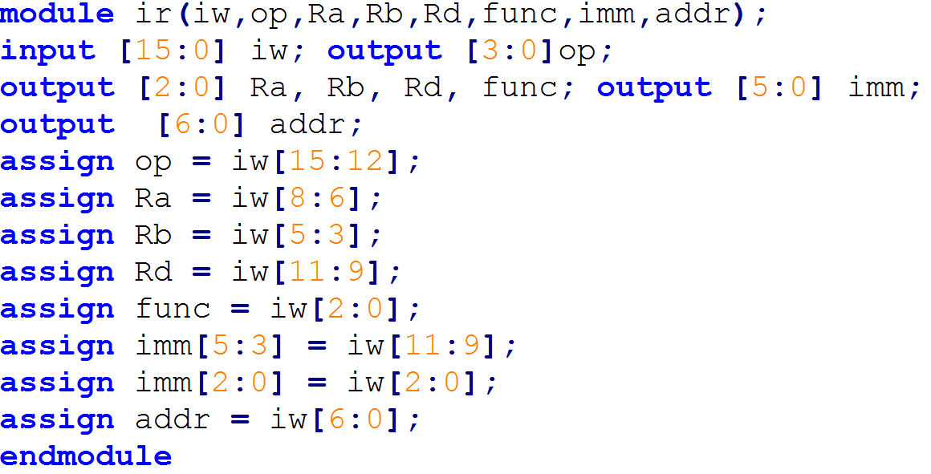
Instruction Register - Code

Slide 9
Control Unit
Op[4]
CU
jump
memtoreg
memwrite
alusrc
regwwrite
branch

Slide 10
CU – Truth Table
I1 | I2 | I3 | I4 | INSTRUCTION | J | Mr | Mw | Rw | Alusrc | bran
0 | 0 | 0 | 0 | regtype | 0 | 1 | 0 | 1 | 0 | 0
0 | 1 | 0 | 0 | addi | 0 | 1 | 0 | 1 | 1 | 0
1 | 0 | 1 | 1 | lw | 0 | 0 | 0 | 1 | 1 | 0
1 | 1 | 1 | 1 | sw | 0 | x | 1 | 0 | 1 | 0
1 | 0 | 0 | 0 | beq | 0 | x | 0 | 0 | 1 | 1
0 | 0 | 1 | 0 | jump | 1 | x | 0 | 0 | x | 0

Slide 11
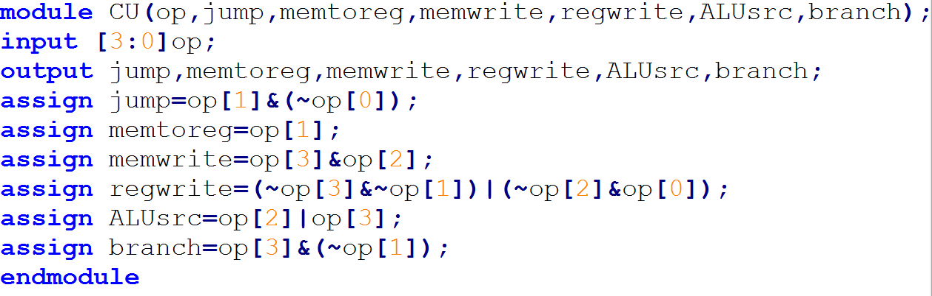
Control Unit - Code

Slide 12
Register File
Regwrite
Wrdata[8]
Wraddr[3]
Clk #1
Register File
iscarry
Ra[3]
Rb[3]
ra[8]
rb[8]

Slide 13
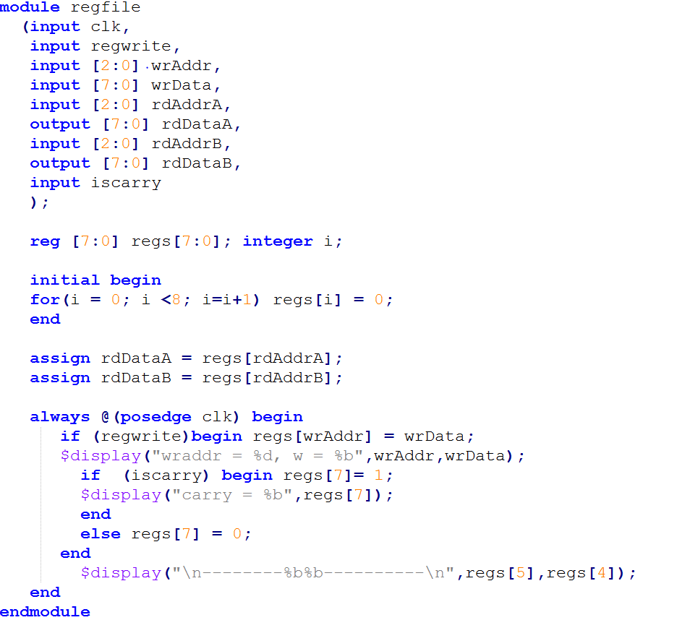
Register File - Code

Slide 14
Arithmetic and Logical Unit
A = ra
B
ALU
iszero
oper
iscarry
overflow
d2

Slide 15
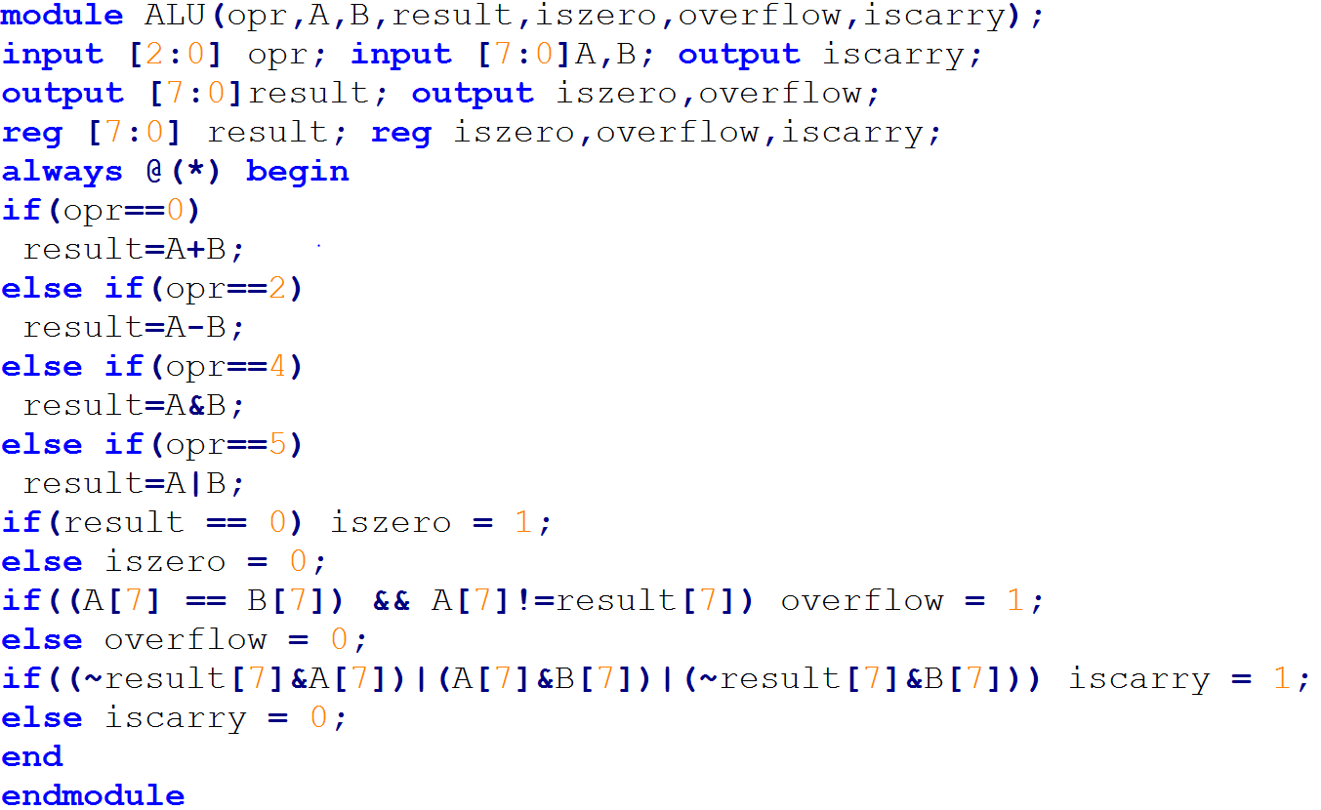
Arithmetic Logic Unit - Code

Slide 16
Data Memory
d2(wraddr)[8]
memwrite
Clk #0
rb[8]
Data Mem
d1[8]

Slide 17
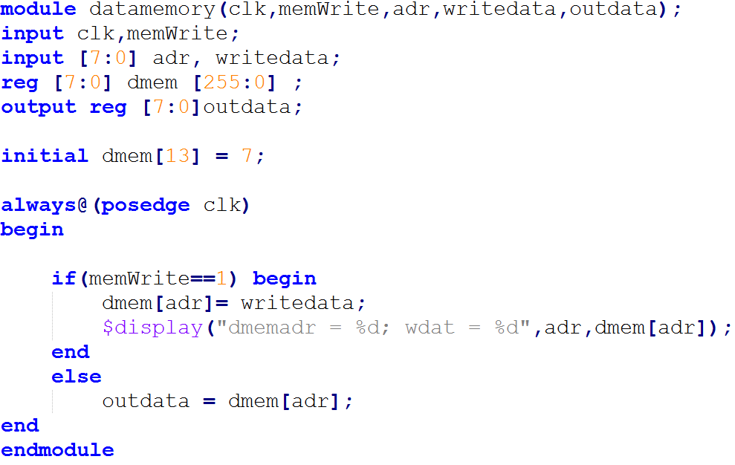
Data Memory - Code

Slide 18
Multiplexers
rb[8]
immex[8]
Rb[3]
Rd[3]
func[3]
imfunc[3]
MUX 1
alusrc
MUX 2
alusrc
MUX 3
alusrc xor
branch
B
Wraddr[3]
oper[3]
d1[8]
d2[8]
Immex+pc[8]
addrex[8]
memtoreg
MUX 4
jump
MUX 5
Wrdata[8]
Addri[8]

Slide 19
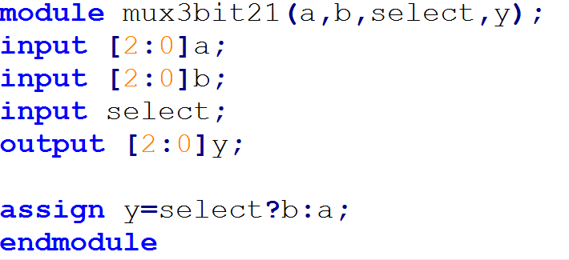
Multiplexers - Code

Slide 20


Other Logics
jump
immfuncgen
branch
load
immfunc[3]
Addr[7]
imm[6]
adrsextender
bitextender
branch
iszero
Addrex[8]
immex[8]

Slide 21
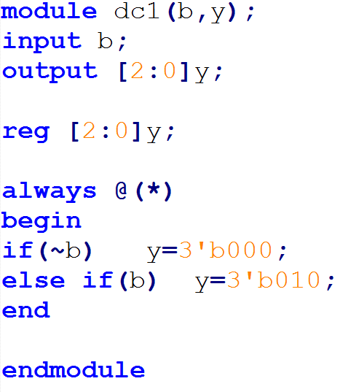
Other Logics – Code 1

Slide 22
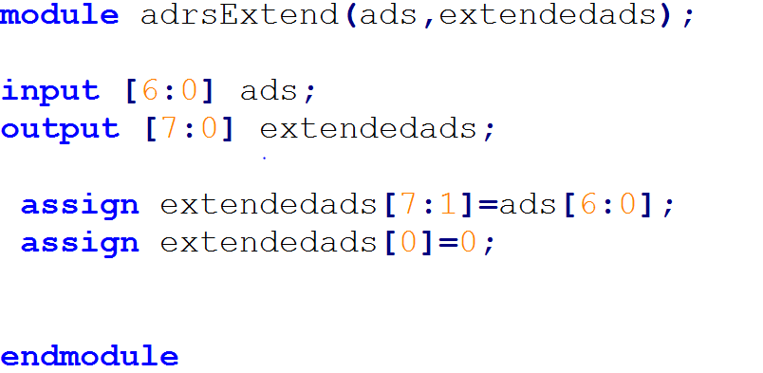
Other Logics – Code 2

Slide 23
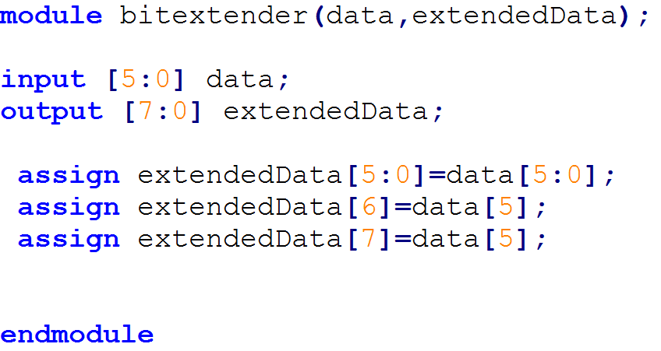
Other Logics – Code 3

Slide 24
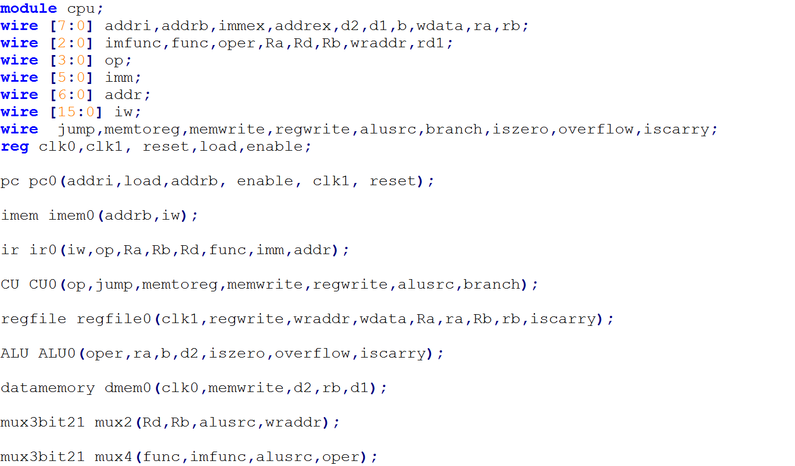
CPU - I

Slide 25
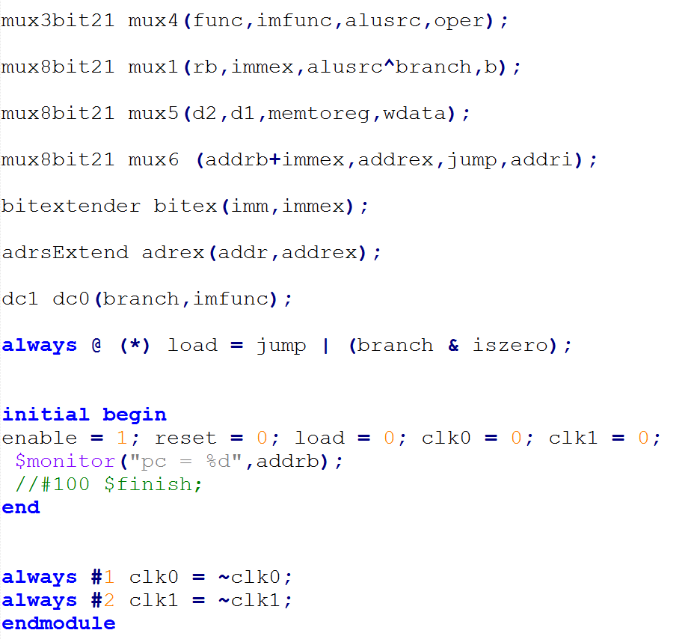
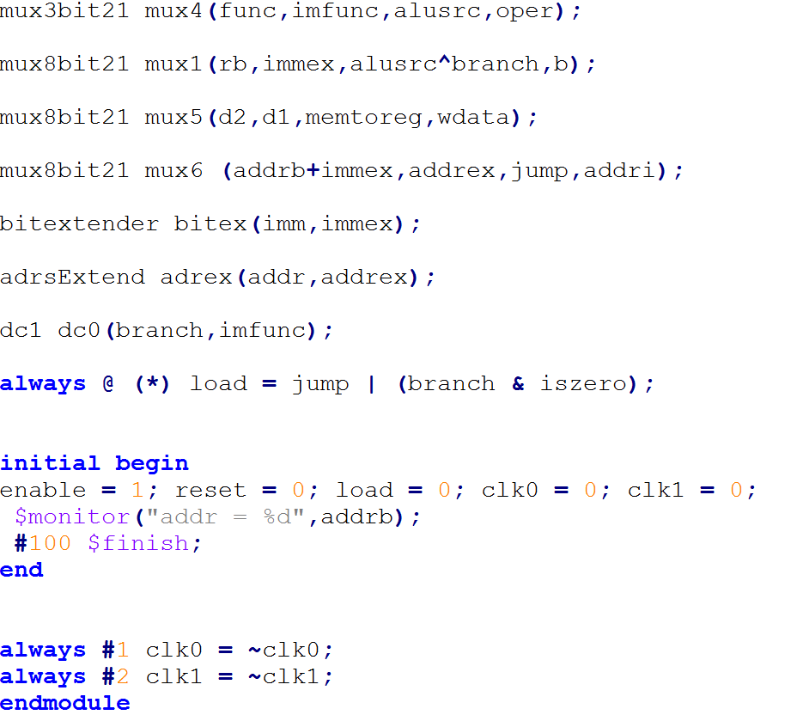
CPU - II

Slide 26
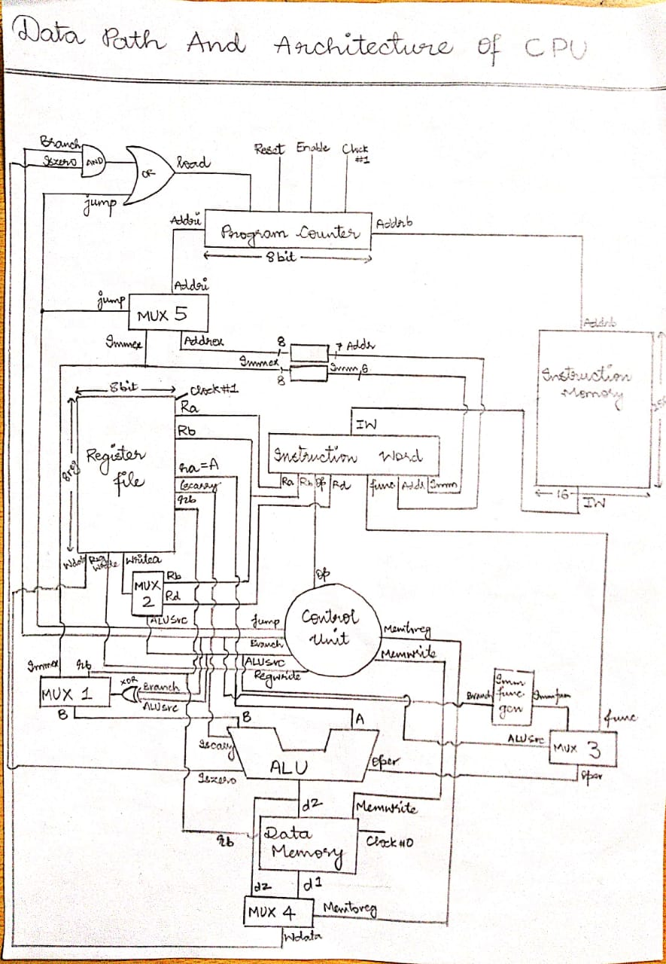

Slide 27
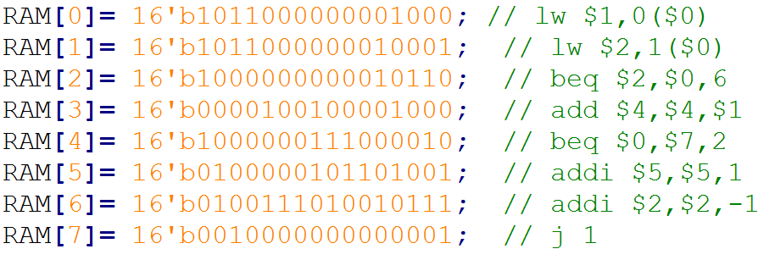
An Example: Multiplication

Slide 28
THANK YOU!!
From :-
IIT2018040 – Manthan Surkar
IIT2018042 – Aman Joshi
IIT2018043 – Abhishek Singh
IIT2018051 – Avishek
IIT2018066 – Laxman Goliya

